Slide 1


Strengthening Resident and Family Councils
Maximizing Resident Engagement
Part I - Appreciation
Notes:
Welcome to this educational program, “ Maximizing Resident Engagement through Appreciation”, part of an initiative on Strengthening Resident and Family Councils.
I’m Paula Griswold, the Executive Director of the Massachusetts Coalition for the Prevention of Medical Errors.
Our Coalition was contracted by the Massachusetts Department of Public Health, sponsor of this initiative to increase resident and family engagement in Massachusetts nursing homes, and improve the quality of life for residents.
The project is funded through the federal government Center for Medicare and Medicaid Services.

Slide 2
Introduction
Goals
  Engage residents and families
  Partner with nursing homes on improvement
  Improve quality of life for residents

Slide 3
Maximizing Engagement through
Appreciation
Kate Waldo, CTRS, ACC
National Director of Recreation and Guest Services

Slide 4
Objectives
Introduce the three elements of an engagement process.
Review the importance of appreciation and active listening as skills for increasing engagement.

Slide 5

The Story of Madame President

Slide 6
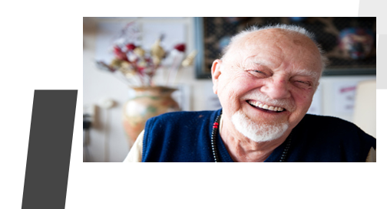
Elements of Engagement Process
Hearing Concerns and Preferences
Listening Deeply to Understand
Engaging Others in Improvement

Slide 7
Engaging Others in Improvement
Testing Changes
Mutual Agreement on Next Steps
Idea Generation
Obtain the Positive Image of the Future

Slide 8

What is Appreciation?
Why is it important?

Slide 9
We can only move in the direction of what we can imagine.
~Bliss Brown
When we focus on the problem:
We get defensive.
We blame others.
Our learning becomes difficult.
When we focus on what works:
  We want to talk.
  We get engaged.
  Our enthusiasm builds.

Slide 10
Think of a time when Residents or a Resident worked with staff or a staff member to create a positive change.
What happened or didn’t happened?
Who was involved?
What made it successful?
What did you value most about the situation?
What about this experience is worth trying again?
Is there anything you would change if you could do it over to make it an even better experience?

Slide 11
Hearing Concerns and Preferences
Appreciate…
  The unique qualities of the person
  The motivating request
  The past success as a springboard for future success and the creation of a positive image of the future.
“The food here is terrible. It is bland and mushy.”
I appreciate your passion about food quality.
It sounds like the area we need to address is the preparation of the food.
Would you share with me a time when the food was prepared the way you like it?

Slide 12
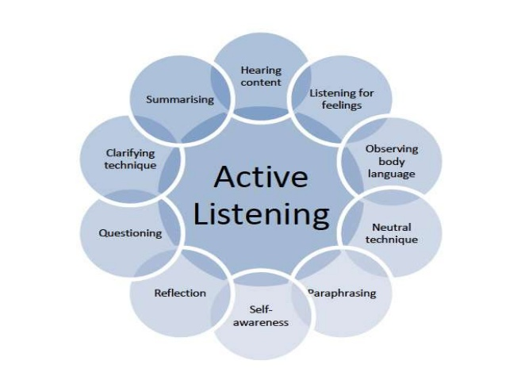
Active Listening
What is active listening?
Listening with our full attention
What skills does active listening involve?
  Body Language
  Tone of Voice
  Paraphrase
  Inquiry

Slide 13
Skills of Active Listening Defined
What is body language?
  The way people communicate through facial expressions, postures, and gestures.
What is tone of voice?
  The way people speak to each other including pitch, volume and intonations.
What is paraphrase?
  Repeating back in one’s own words what the speaker has said to ensure understanding of the facts, feelings or both.
What is inquiry?
  Using open or closed questions to clarify or gather additional information.

Slide 14
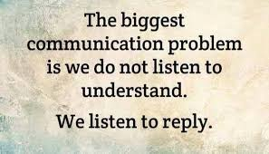
Listening Deeply to Understand
How might using the skills of Active Listening increase engagement?

Slide 15
Part I- Maximizing Engagement through Appreciation
Part II-Maximizing Engagement through
Accommodations and Adaptation
Kate Waldo, CTRS, ACC
National Director of Recreation and
Guest Services

Slide 16
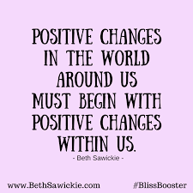
Commitments for Next Steps
What can you personally change or try?
Patience
Practice
Persistence
Perseverance

